Slide 1
Greek Minuscule Script
Font and Keyboard presentation
Konstantina Eleftheriadi
M.NR.: 7418145
Übung Preserve our shared Cultural Heritage – Recorded Data, Writing Systems, Scripts
Lecturer: Vyshantha Simha
Summer Semester 2024

Slide 2
Structure
The Greek Minuscule
The font
The keyboard
Purpose
Refinement

Slide 3
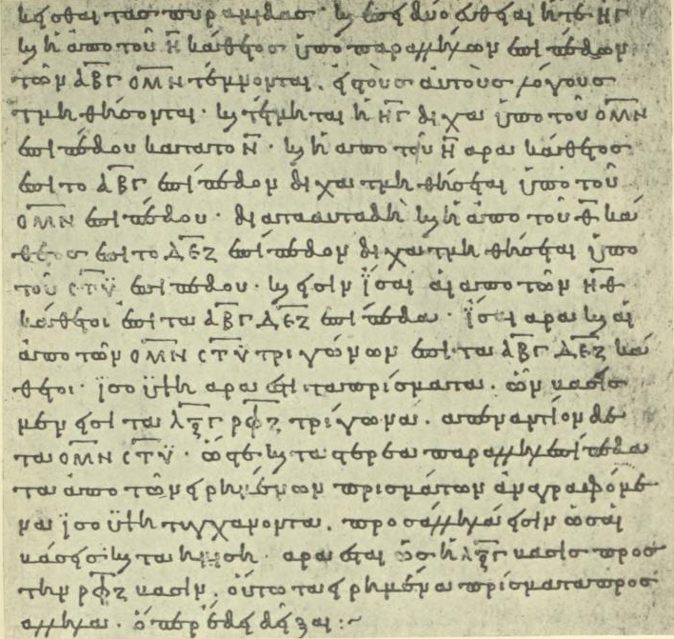
The Greek Minuscule
Development: 9th-10th c. in Constantinople
Commonly used in Byzantine Manuscripts after the 10th c.
Different styles, traditionally categorized in 4 larger periods (Thompson 1911)
Codices Vetustissimi (9th-mid. 10th. c.)
Codices Vetusti (mid. 10th-mid. 13th c.)
Codices Recentiores (mid. 13th-mid. 15th c.)
Codices Novelli (mid. 13th-…)
Bodleian Euclid, 888 C.E. (Thompson 1911, 223)

Slide 4
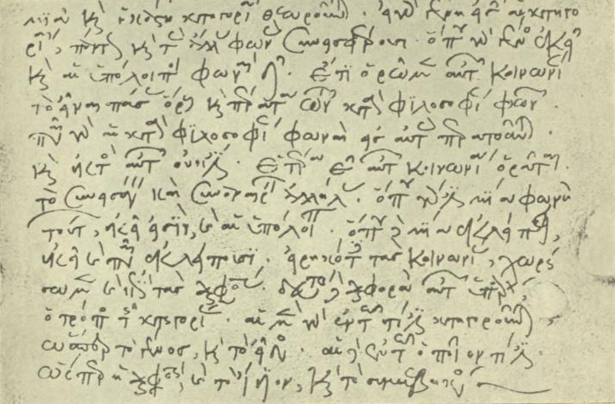
The Greek Minuscule (cont.)
Lower-case letters;
though oftentimes upper-case letters (uncial) intermixed
Duplicate(+) forms of letters
Ligatures
Abbreviations
“Formal” and “neat”, yet steadily developed more freely –and diversely
Commentary on Porphyry, 1223 C.E.. (Thompson 1911, 251)

Slide 5
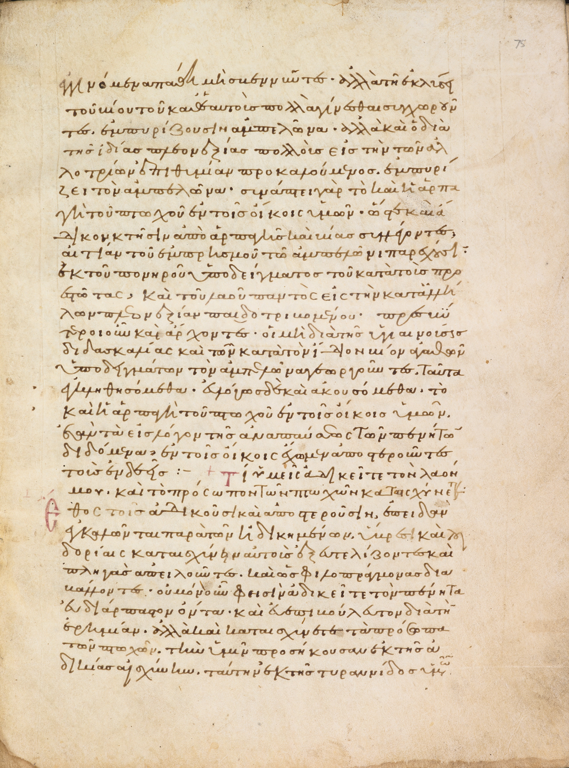
The Font
Based on the Bodleian – MS. Barocci 102 Manuscript (Commentary on Isaiah by Basil the Great)
Dated: 1090-1100
Typical example of 11th c. Minuscule script
Readable and in fairly good condition
Transcribed
Fully digitized and available online
Bodleian MS. Barocci 102 fol. 75r

Slide 6
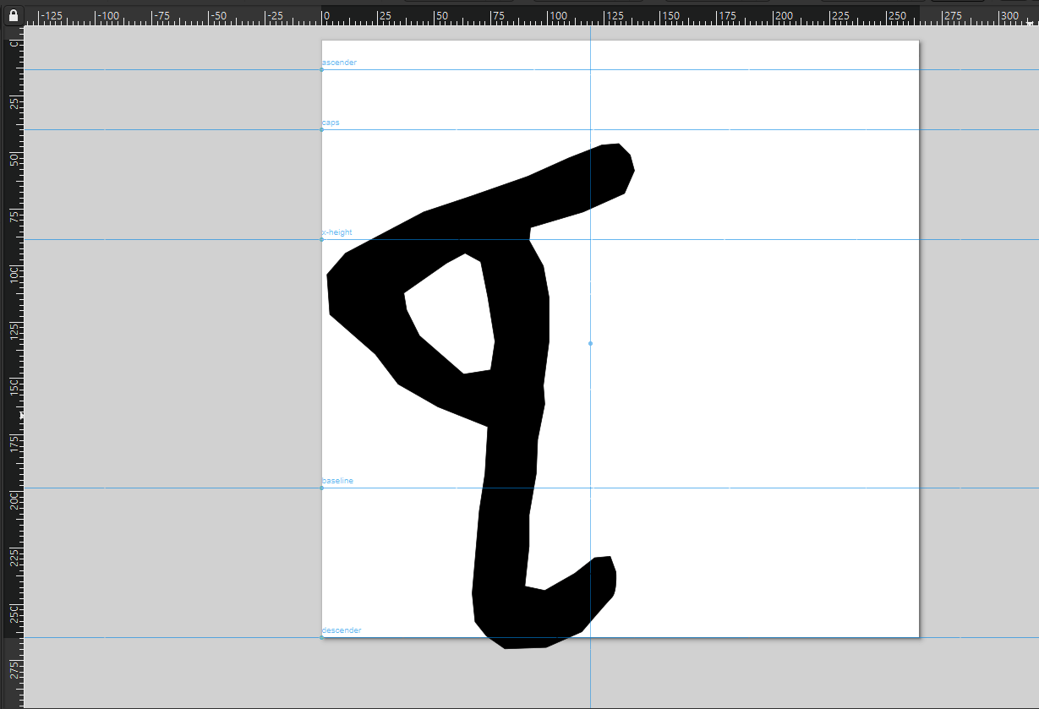
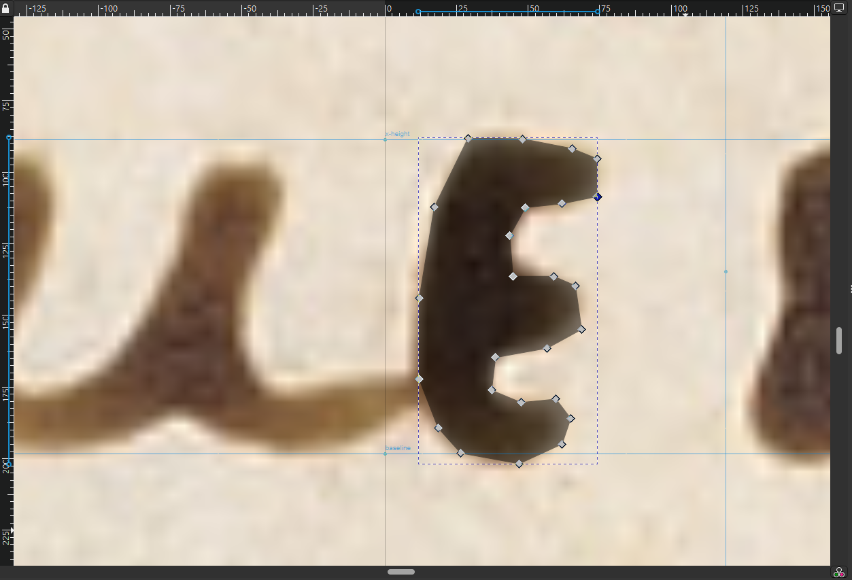
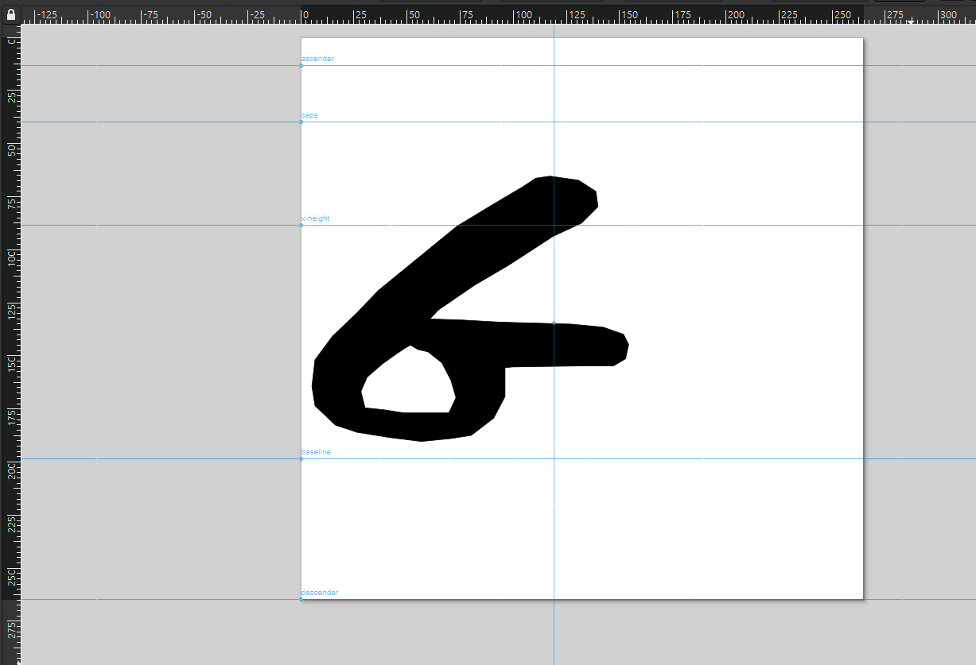
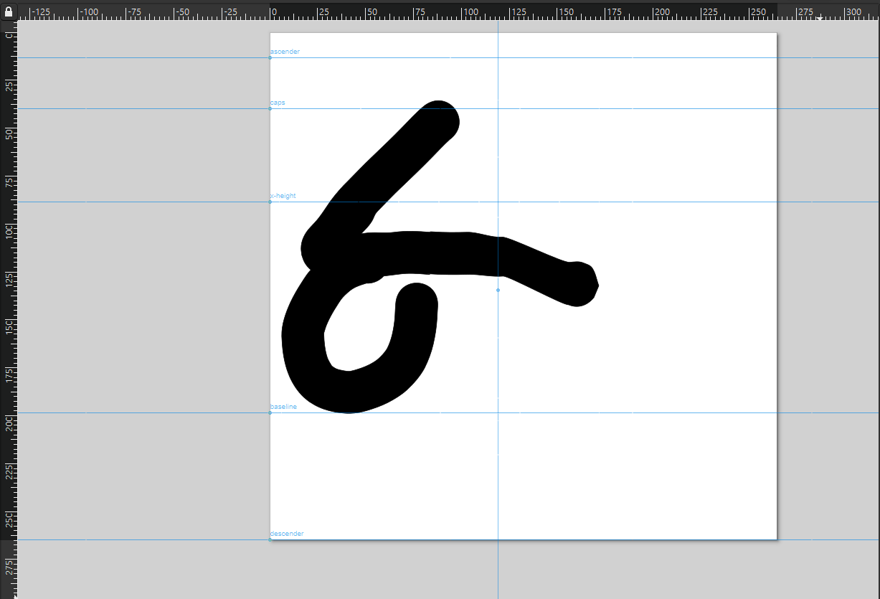
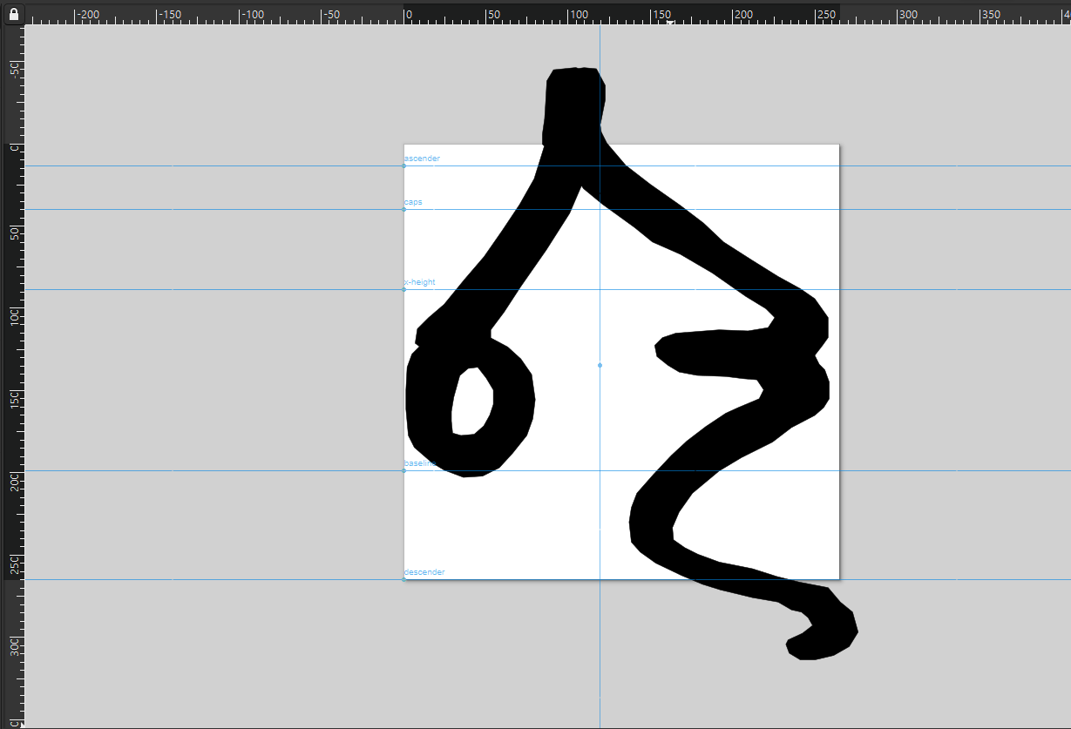
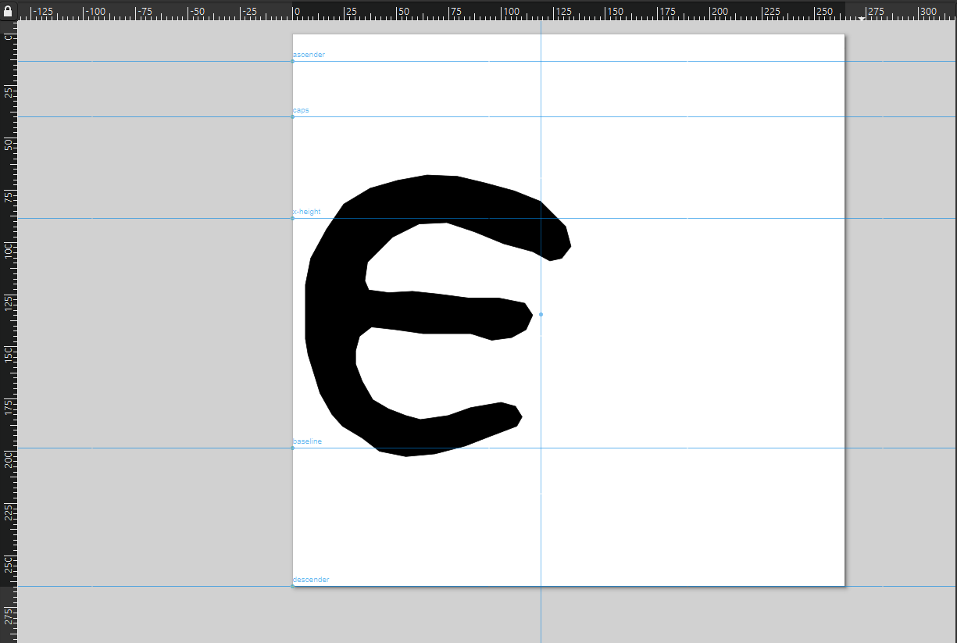
The Font (cont.)
Methodology:
Inkscape
Tracing of characters and assignment to Greek Unicode letters (lower-case and upper-case)
PUA for:
Variant forms of characters (3)
Ligatures (14)
Connector Characters (8)

Slide 7
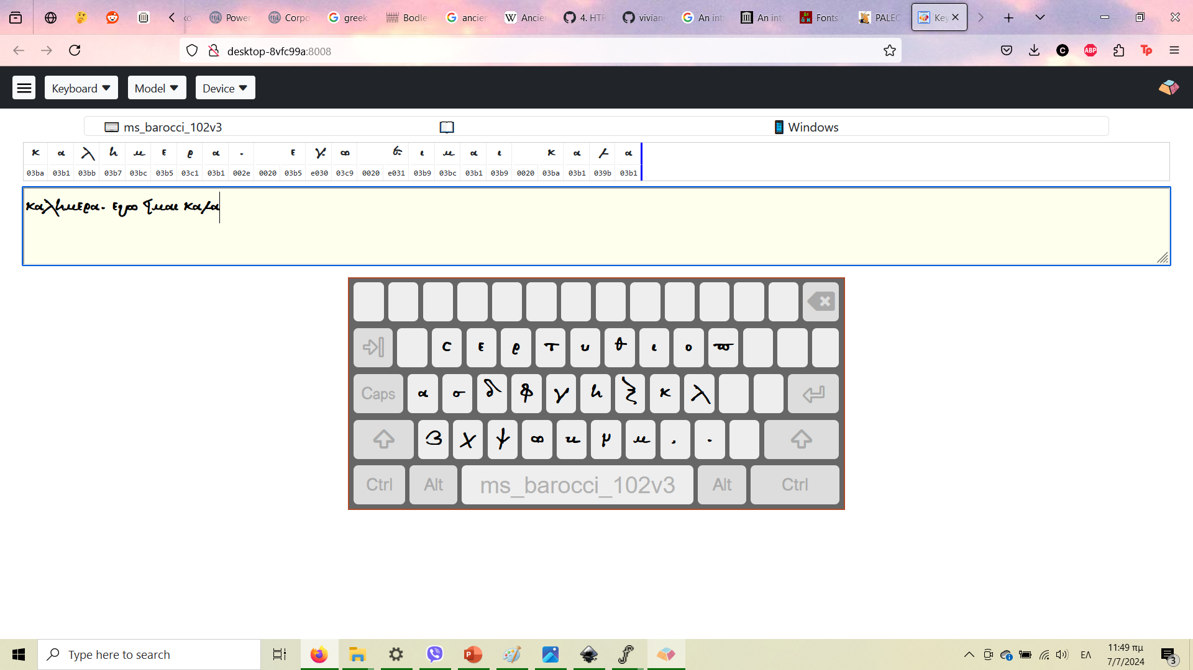
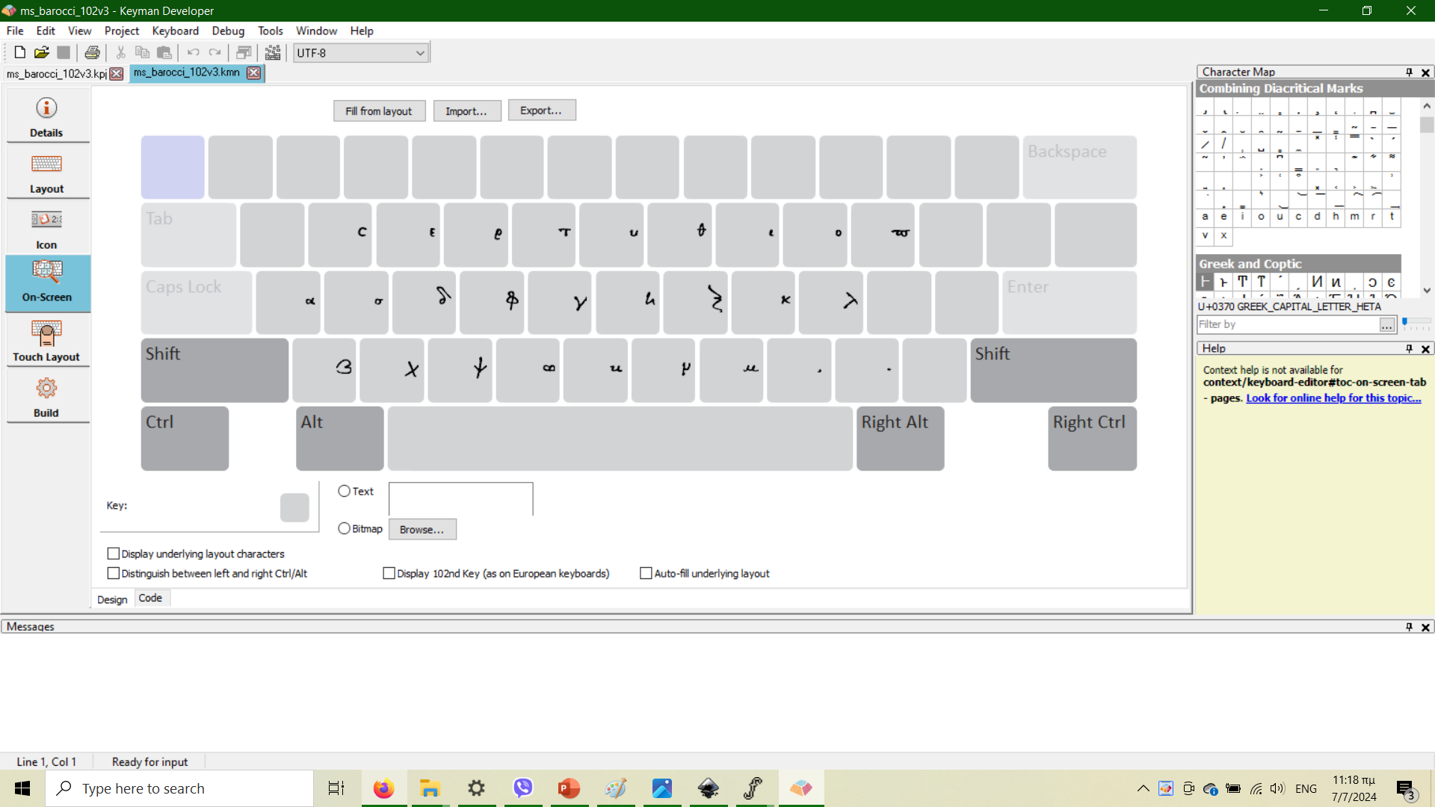
The Keyboard
FontForge
Fixing of nodes
Fixing of positioning (baseline, height, spacing)
Keyman Developer
Development of physical and on-screen keyboard

Slide 8
Purpose
Diplomatic transcription of manuscripts
Dating and contextualization
Use in DL Networks for de-coding manuscripts
Teaching and education
Public outreach and entertainment
Cavafy script by the Onassis Foundation

Slide 9
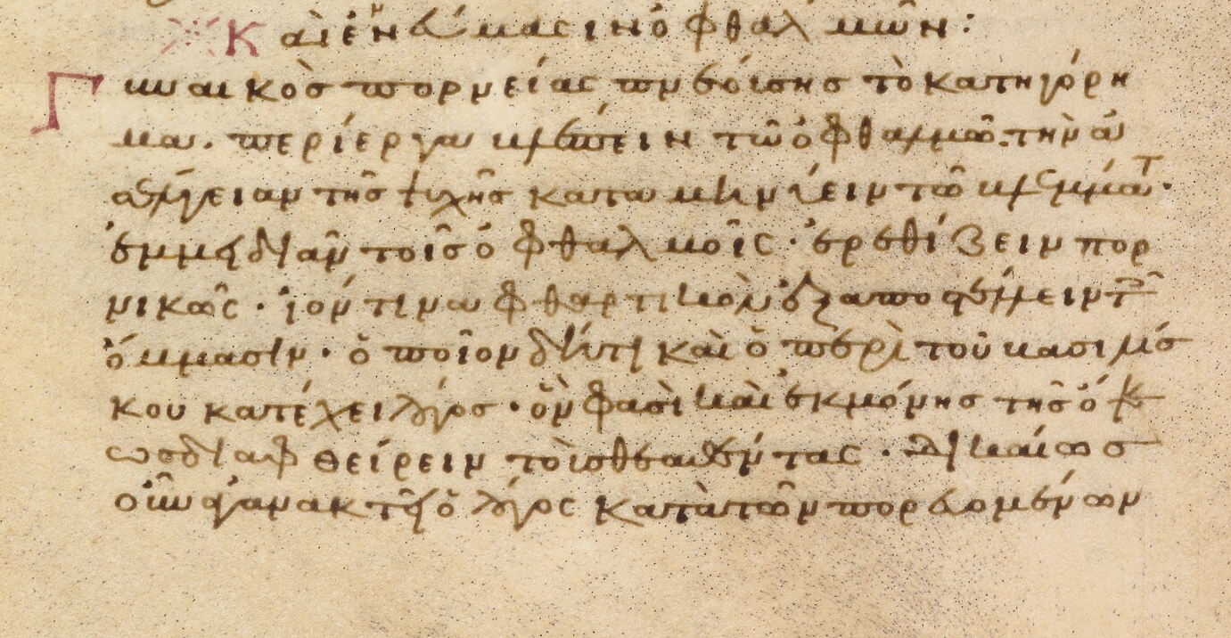
Refinement
Additions:
More variants (if applicable)
More ligatures (if applicable)
Accent marks and diacritics
Special characters
Rethinking variant forms and ligatures
Following example of Athena Ruby?
Implementation of different color schemes

